Slide 1
How Software Interpreter's & Compilers Work

Slide 2
Overview
In this lecture we will look at how software interpreters and compilers work.
At the end of this lecture, you should be able to:
-Understand what the differences are between the two
-Understand and describe how each part of the compiler works
-Able to describe how software interpreters work

Slide 3
Introduction
What is an software interpreter?
It is a computer program that performs instructions that are written in a programming or scripting language without compiling them into machine language.
Examples
Batch files
Word macros
Perl
Python
Java programs written for use on the Internet
echo off
Title Back up and Restore Batch file
:menu
cls
echo ********************************************************
echo:
echo Enter the selected number to run that operation
echo 1. To back up a directory using Robocopy
echo 2. To restore a directory using Robocopy
echo 3. Exit this batch file
echo:
echo *********************************************************
set /p choice="Enter the number of the operation you wish to run: "
if "%choice%"=="1" goto one
if "%choice%"=="2" goto two
if "%choice%"=="3" exit

Slide 4
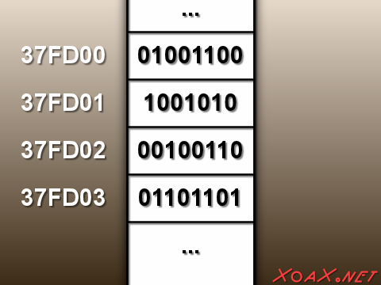
How a Software Interpreter Works – Part 1
When you run an interpreted program, such as a batch file, an interpreter designed for that particular language establishes a small area in memory. There the interpreter puts the name of the file in that memory area and keeps track of it’s current place which is called the offset.
The offset is measured in the number of
lines the current command is from the
beginning of the file.

Slide 5
Step 1 Continued
As the interpreter reads each line of the file, it compares the first word in the line to a list of valid commands.
In some cases, such as a BASIC program, the interpreter will recognize a variable at the start of a line. A variable can hold letter(s) or digits.

Slide 6
Step 2
In a batch file, the interpreter will look for .com or .bat or .exe if the first word of a line is not found.
In a BASIC program, the interpreter will generate an error message if the first word of a line is not a variable or a command.

Slide 7
Step 3
If the word is a valid command or a variable, the interpreter executes the entire line, translating the command word along with words that represent the parameters on which the command word is operating.
For example: del test.docx
Del is the command and test.docx is the parameter

Slide 8
Step 3 Continued
Commands and/or variables that are valid are turned into tokens
Tokens are an abbreviation for instructions that are passed to CPU which carries out the instructions.
If commands and/or variables are not valid or they attempt to perform a forbidden operation such as copying a file over itself, the interpreter will generate a syntax error.

Slide 9
Step 4
After the line has been processed, the interpreter retrieves and offset location and repeats the procedure for the next line.
The exception to this is if a command such as GOTO or an IF statement branches execution to another section of the program

Slide 10
How Compilers Work
The compiling process starts with a part of the compiler program called the scanner. The scanner is also know a lexer. For the purposes of this course, I will use both terms.
The Lexer reads the entire source code, one character at a time, and performs a process called lexical analysis. As it reads characters it tries to assemble them into reserved words – computer commands or punctuation characters that it understands.
Steps:
Lexer
Parser
Code generator
Optimization

Slide 11
Scanner Continued
The scanner removes:
Whitespaces
Written comments by be the programmer
Carriage returns
When the scanner comes across a reserved word or punctuation mark , it generates a token

Slide 12
Scanner continued
When the scanner finds a string of characters it doesn’t form a reserved word, it assumes it’s a variable.
It assigns the variable to an identifier table that tracks the name and contents of that variable.
The scanner then generates a variable token for each variable in the identifier table.
When the scanner finds a string of numeric characters, it converts the string into an integer then converts the integer into a token to stand for it.

Slide 13
Identifier Table
If x>3 THEN Y=2 ELSE Y=Z+3
Variable | Content
X | 4
Y | 2
Z | 1

Slide 14
Scanner Continued
The end result of the Scanner/Lexer analysis is a stream of tokens that represent everything of significance in the program.
Such as
Commands
Variables
Numbers

Slide 15
The Parser
A second part of the compiler, is called the Parser, it performs a syntactic analysis, which evaluates the stream of tokens that the Lexar created. The parser converts each token into a node on a syntax tree that represents the program’s logical flow.

Slide 16
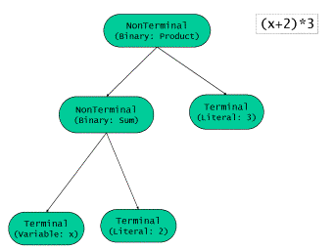
Syntax tree for (x+2)*3

Slide 17
Parser Continued
Each node on the tree represents a program operation that generates data or an instruction that is passed to the node above it. The node, in turn performs another operation that passes that result to the node above it.
When the parser is finished, the compiler has converted the entire program into a tree that represents the program structure. The top most node is called the program and the nodes that pass results to it are called routine 1, routine 2, etc…. All the way down to very specific nodes at the bottom of a tree.

Slide 18
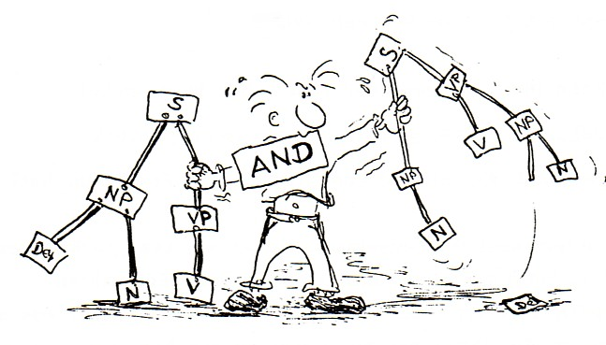
A fourth semester computer engineering –computing science student constructing a Parse tree

Slide 19
Code Generator
A third part of the compiler, is called the code generator. It works its way through the syntax tree, producing segments of machine code of each node. To each node on the tree, the generator matches a template of machine code to the operation assigned to that node.
The generator fills in the blanks in each template with the values and variables found each node.

Slide 20
Code Generator continued
After each template is filled , it is added to the string of binary numbers that constitute the machine language and values of the program.

Slide 21
Code Optimizer
The final step, the optimizer inspects the code produced by the code generator looking for redundancies. It eliminates an operation that produces results identical to those of the preceding operation, making the program turned out by the compiler smaller and faster.

Slide 22
Difference between a Compiler and Interpreter
Both Interpreters and Compilers translate program source code, such as BASIC and C++, that Humans understand into machine code that computers understand.
The difference is this:
An interpreter translates the source code line by line, each time the source code is run.
A Compiler translates the source code into an executable file, that the computer runs without an interpreter. Most commercial programs are compiled programs

Slide 23
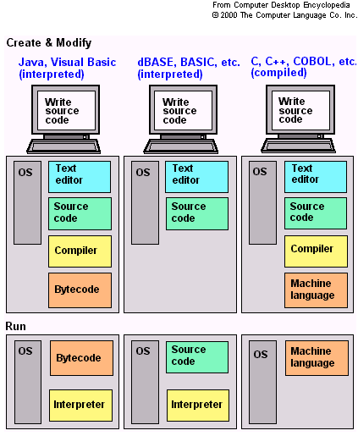
Difference between an Interpreter and a Compiler

